Slide 1
Technical and Vocational University
Minab Branch
Course
Programming Languages Design
and Laboratory
Lecturer
Mohammad Ahmadzadeh
Fall of 2023

Slide 2
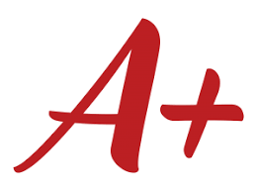
Grading structure
N | Title | Score | Delivery
1 | Report1 : Language | 10 | 02/08/30
2 | Report 2 : Evaluation of two PL | 15 | 02/09/10
3 | Presentation | 10 | 02/07-09
4 | Coding Exercises | 15 | ---
5 | Written Exam | 25 | 02/08/…
6 | Practical Project | 25 | 02/10/…
7 | Research | Unlimited | 02/08/20
Github.com/mohammadbtc100

Slide 3
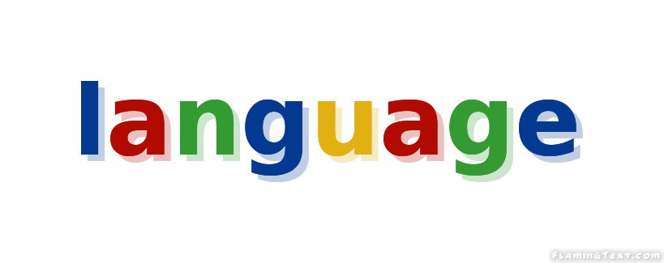
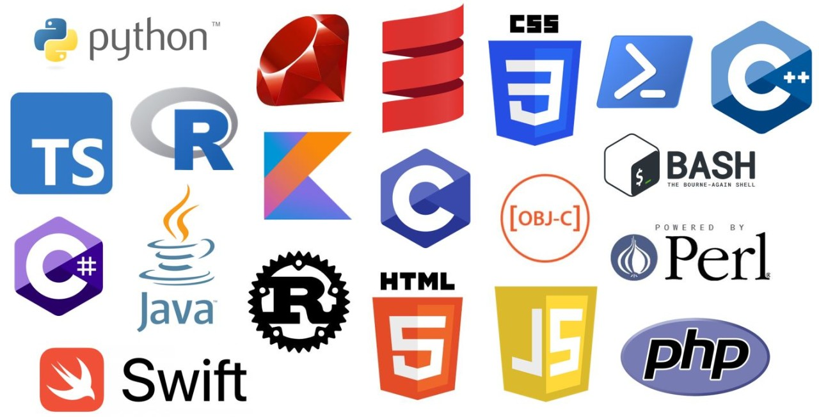
Content at the Glance
History
Theories
Paradigms
Languages

Slide 4
Chapter 1
History

Slide 5
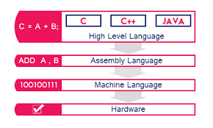
Code Layers

Slide 6
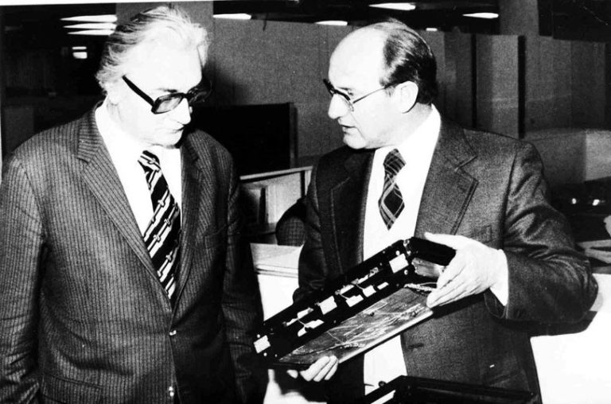
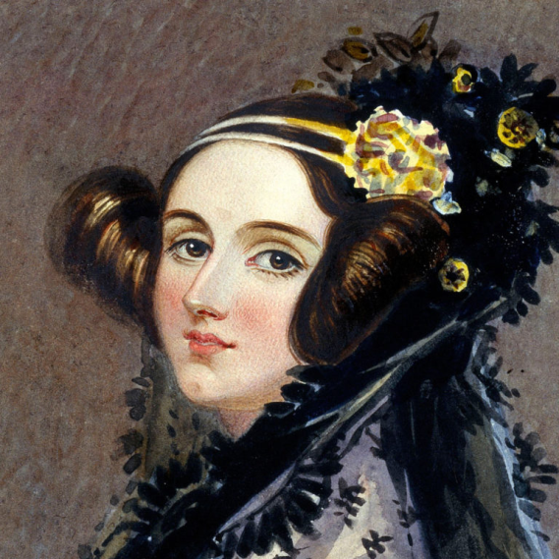
History of programming languages
1943: Ada Lovelace’s machine algorithm Ada Lovelace invents the first-ever machine algorithm for Charles Babbage’s Difference Machine that lays the foundation for all programming languages.
1944-45: Plankalkül Somewhere between 1944-45, Konrad Zuse developed the first ‘real’ programming language called Plankalkül (Plan Calculus). Zeus’s language (among other things) allowed for the creations of procedures, which stored chunks of code that could be invoked over and over to perform routine operations.
Game Changer
Konrad Zuse
Ada Lovelace

Slide 7
History of programming languages
1949: Assembly Language was used in the Electronic Delay Storage Automatic Calculator (EDSAC). Assembly language was a type of low-level programming language that simplified the language of machine code. In other words, the specific instructions necessary to operate a computer.
1949: Shortcode (or Short-order code), was the first High-Level Language (HLL) suggested by John McCauley in 1949. However, it was William Schmitt who implemented it for the BINAC computer the same year and for the UNIVAC in 1950.
1952: Autocode was a general term used for a family of programming languages. First developed by Alick Glennie for the Mark 1 computer at the University of Manchester, Autocode was the first-ever compiled language to be implemented meaning that it can be translated directly into machine code using a program called a compiler. Autocode was used on the Ferranti Pegasus and Sirius early computing machines in addition to the Mark 1.
Game Changer

Slide 8

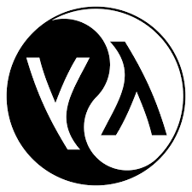
History of programming languages
1957: FORTRAN, FORmula TRANslation or FORTRAN was created by John Backus and is considered to be the oldest programming language in use today. The programming language was created for high-level Scientific, Symbolic, Mathematical, and Statistical computations. FORTRAN is still in use today in some of the world’s most advanced supercomputers.
Game Changer
1958: LISP (List Processor)
Originally purposed for artificial intelligence
Invented by John MvCarthy at MIT
Formal notation for Lambda-Calculus => Functional Programming
Pioneered many PL concepts : Garbage collection, Dynamic Types
No distinction between code and data

Slide 9

History of programming languages
1958-60: ALGOL 60(Algorithmic Language)
Peter Naur
Great influence on Modern Languages
Formally specified syntax(BNF)
Algorithmic View
Lexical Scoping, Modular Procedures, Recursive Procedures, Variable Type declarations, Stack Storage allocation
A procedure can be passed to a Procedure
Recursive call of a Procedure
ALGOL served as the starting point for the development of some of the most important programming languages including Pascal, C, C++, and Java.
disadvantages : side-effect, unlimited jump by goto, send parameter only by name
Algo68 has type conversation for example float to int
Fortran-> Algol -> Pascal -> Ada -> …
Game Changer

Slide 10
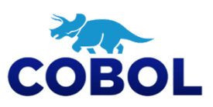
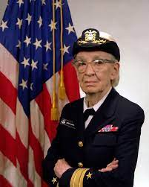
History of programming languages
1959: COBOL (Common Business Oriented Language), is the programming language behind many credit card processors, ATMs, telephone and cell calls, hospital signals, and traffic signals systems (just to name a few). The development of the language was led by Dr. Grace Murray Hopper and was designed so that it could run on all brands and types of computers. COBOL is still used to this day primarily for banking and gamification systems.
Sample
English like
stable
Business Oriented
Robust
Easy to Read
Game Changer
Grace Hopper

Slide 11

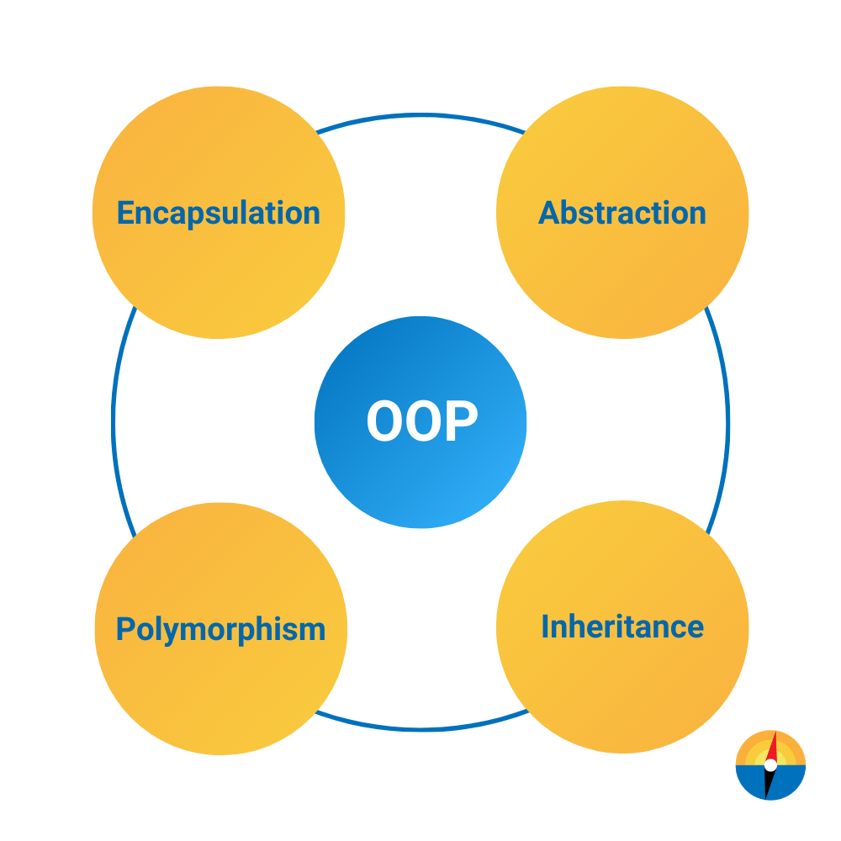
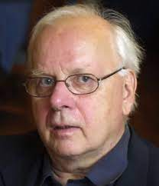
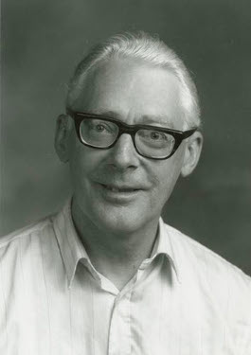
History of programming languages
1960 : Simula
Ole-Johan Dahl(1931-2002), Kristen Nygaard(1926-2002)
at the Norwegian Computing Center in Oslo
it is an approximate superset of ALGOL 60
First-Oriented Language
Virtual Procedures
Simula is the name of two simulation programming languages
Simula->Smalltalk
Game Changer
Kristen Nygaard
Ole-Johan Dahl

Slide 12
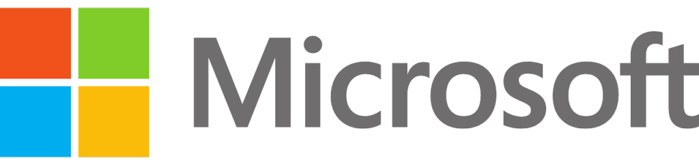
History of programming languages
1964: BASIC (Beginner’s All-Purpose Symbolic Instruction Code) was developed by a group of students at Dartmouth College. The language was written for students who did not have a strong understanding of mathematics or computers. The language was developed further by Microsoft founders Bill Gates and Paul Allen and became the first marketable product of the company.
Game Changer

Slide 13

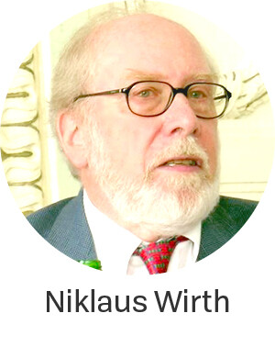
History of programming languages
1970: PASCAL Named after the French mathematician Blaise Pascal, Niklaus Wirth developed the programming language in his honor.
Range, Subrange, Variant, and Records
Send parameter by Call by value
And Call by reference
Revised Type System of Algol
It gives the programmer the power to choose the method of passing the parameter.
Algol Like
It was favored by Apple in the company’s early days,
because of its ease of use and power.
Game Changer

Slide 14
History of programming languages
1972: Smalltalk developed at the Xerox Palo Alto Research Centre by Alan Kay, Adele Goldberg, and Dan Ingalls, Smalltalk allowed for computer programmers to modify code on the fly. It introduced a variety of programming language aspects that are visible languages of today such as Python, Java, and Ruby. Companies such as Leafly, Logitech, and CrowdStrike state they use Smalltalk in their tech stacks.
1972: SQL (SEQUEL at the time) was first developed by IBM researchers Raymond Boyce and Donald Chamberlain.
1978: C developed by Dennis Ritchie
1980/81: Ada was originally designed by a team led by Jean Ichbiah of CUU Honeywell Bull under contract to the United States Department of Defense. Ada was extended from Pascal
1983: C++ Bjarne Stroustrup modified the C language at the Bell Labs
Game Changer

Slide 15
History of programming languages
1983: Objective-C developed by Brad Cox and Tom Love, Objective-C is the main programming language used to write software for macOS and iOS, Apple’s operating systems.
1987: Perl was created by Larry Wall and is a general-purpose, high-level programming language. It designed for text editing.
1990: Haskell is a general-purpose programming language named after the American logician and mathematician Haskell Brooks Curry. It is a purely functional.
1991: Python named after the British comedy troupe ‘Monty Python’, Python was developed by Guido Van Rossum. It is a general-purpose, high-level programming language.
1991: Visual Basic developed by Microsoft, Visual Basic allows programmers to utilize a drag-and-drop style of choosing and changing pre-selected chunks of code through a graphical user interface (GUI)
1993: Ruby created by Yukihiro Matsumoto, Ruby is an interpreted high-level programming language. A teaching language which was influenced by Perl, Ada, Lisp, and Smalltalk.
Game Changer

Slide 16
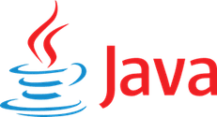
History of programming languages
1995: Java is a general-purpose, high-level language created by James Gosling for an interactive TV project. It has cross-platform functionality.
Originally called Oak
Interface, Single Inheritance, Exception handling, built-in threading model, references & automatic garbage collection
no multiple inheritance, no operator overloading
Java=C++ + Modula-3
JSP(Java Server Page) is used for web development in Java language.
Game Changer
Framework :
Spring
Hibernate
Strut
Application:
Web, Mobile and Desktop
Enterprise
Financial

Slide 17
History of programming languages
1995: PHP, Formerly known as ‘Personal Home Page’ which now stands for ‘Hypertext Preprocessor’, PHP was developed by Rasmus Lerdorf. Its primary uses include building and maintaining dynamic web pages, as well as server-side development.
1995: JavaScript, was created by Brendan Eich.
2001: C# developed at Microsoft with the hope of combining the computing ability of C++ with the simplicity of Visual Basic.
2003: Scala developed by Martin Odersky, Scala which combines mathematical functional programming and organized object-oriented programming on Java Virtual Machine.
2003: Groovy derived from Java, Groovy was developed by James Strachan and Bob McWhirter. The language improves productivity because of its succinct and easy to learn.
2009: Go developed by Google
2014: Swift developed by Apple as a replacement for C, C++, and Objective-C
2015 : Rust developed by Mozilla
Game Changer

Slide 18
Top Languages -> TIOBE Index for September 2023

Slide 19
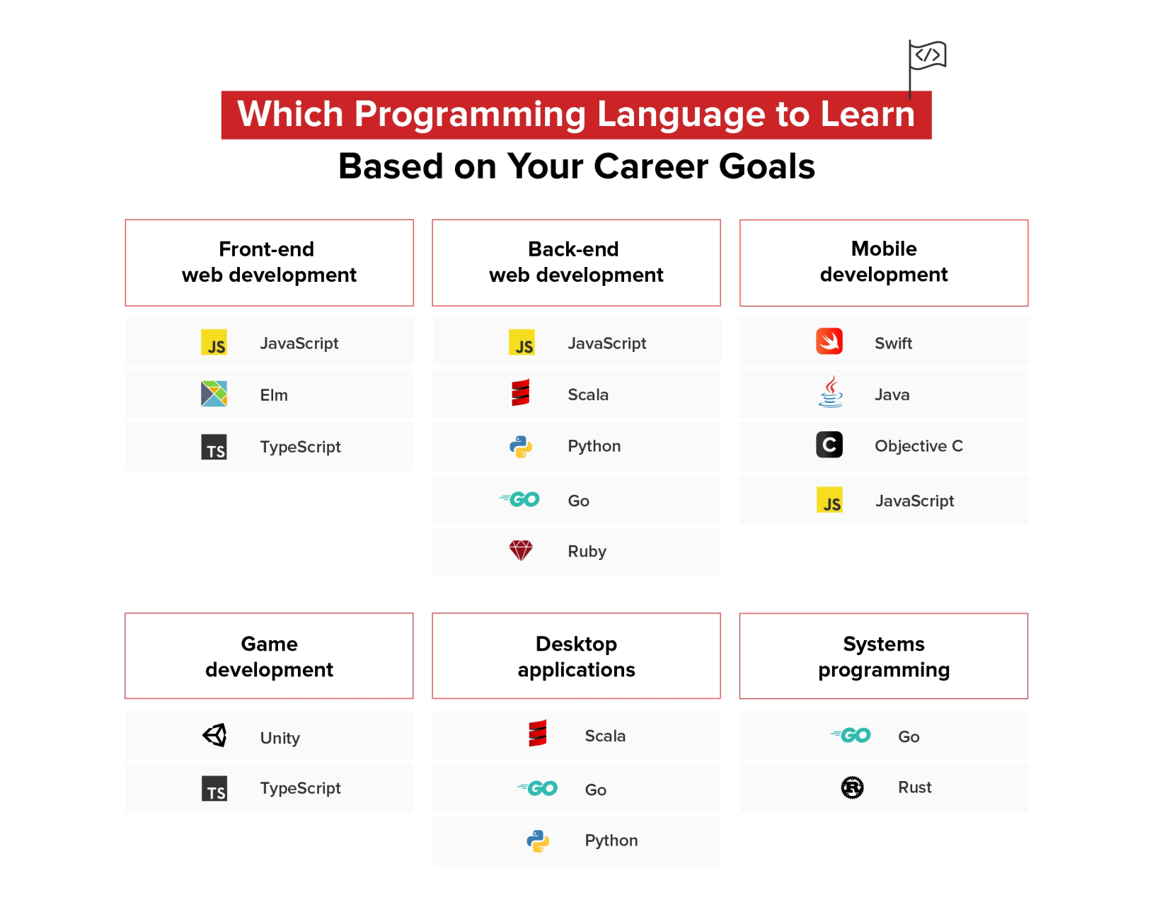
Applications

Slide 20
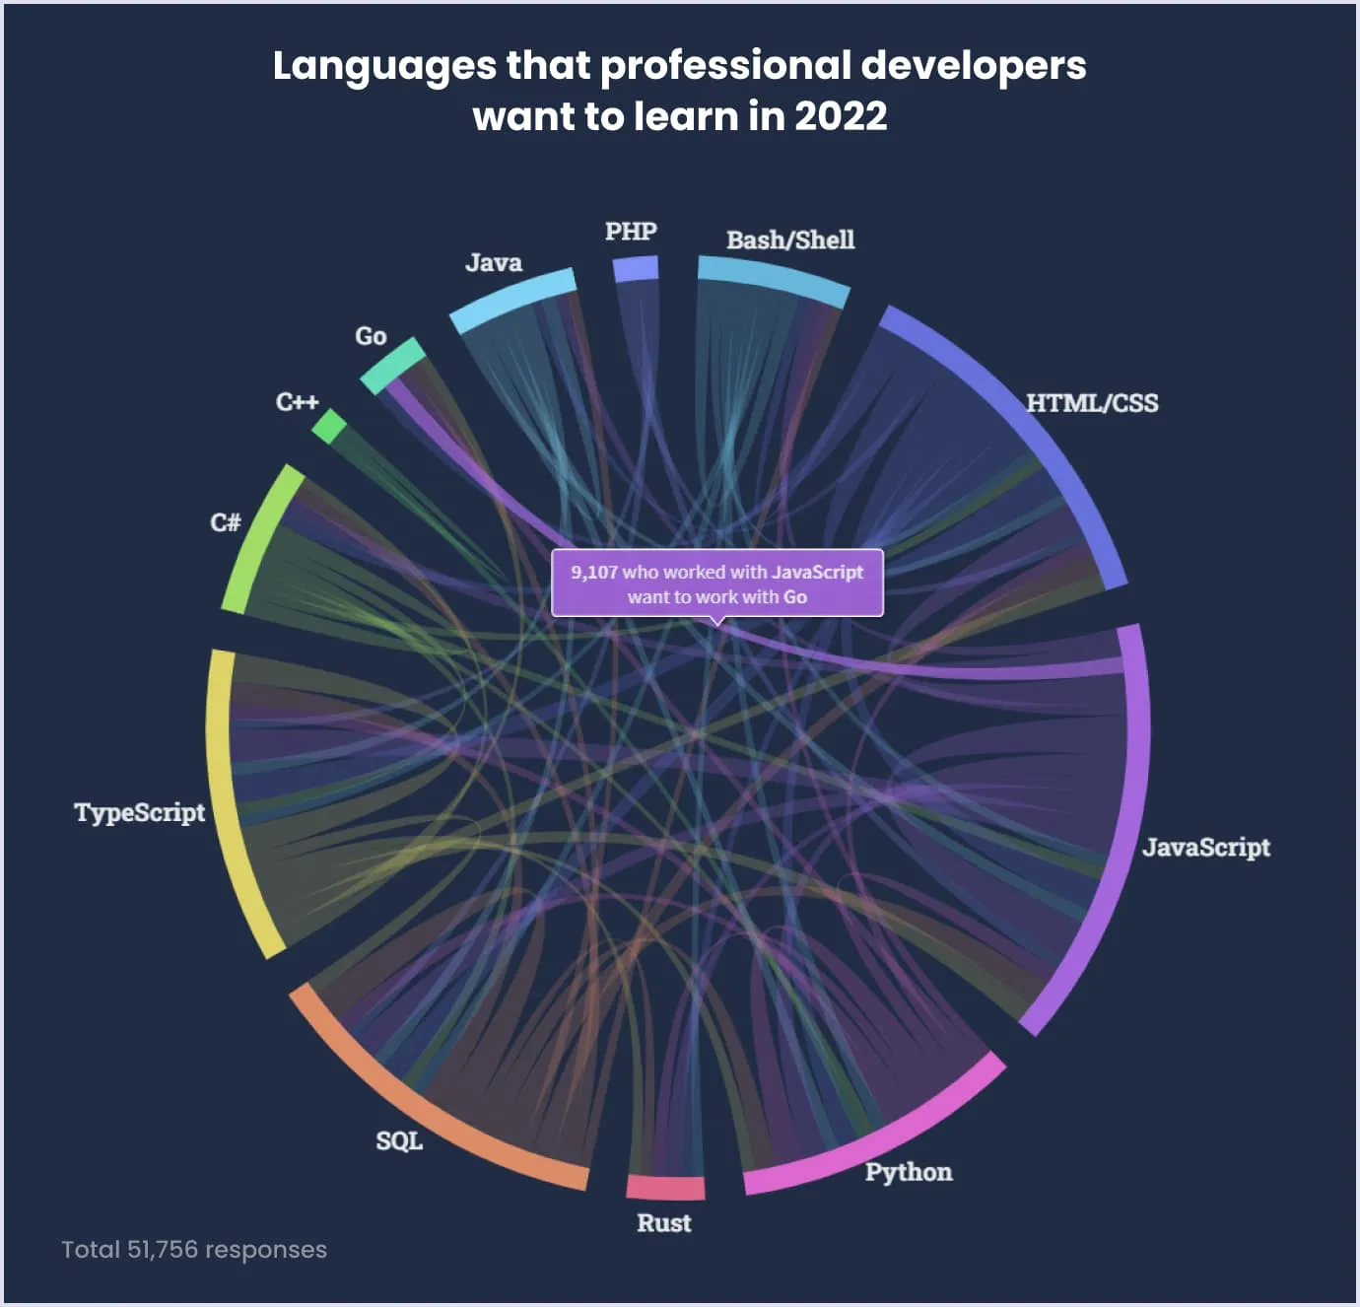
Languages that Professional developers want to learn

Slide 21
Chapter 2
Theories

Slide 22
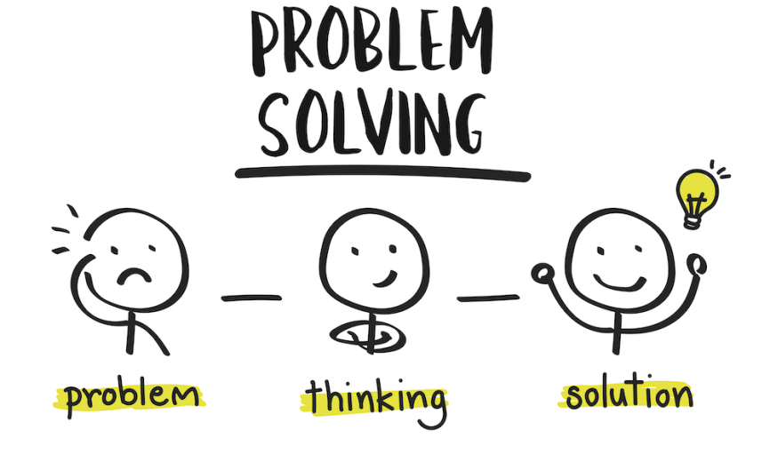
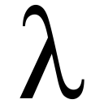
Main Theories
N | Theory | Paradigms
1 | Predicate logic | Logic Programming
2 | Turing Machine | Imperative Programming
3 | Lambda Calculus | Functional Programming
4 | Automata Theory | Recursive Functions & Automata, Regex
Machine Theory and Automata
Compiler Design
Programming Language Design

Slide 23
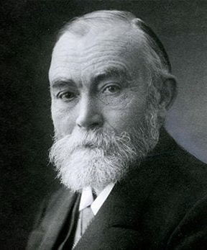
Predicate logic
Formal Basis for Proof Theory and automated Theorem proving
Gottlob Frege, Logition, Germany(1848-1925)
Mathmatics Logic field
Logic Programming : Computation as Logical deduction
Example : Prolog

Slide 24
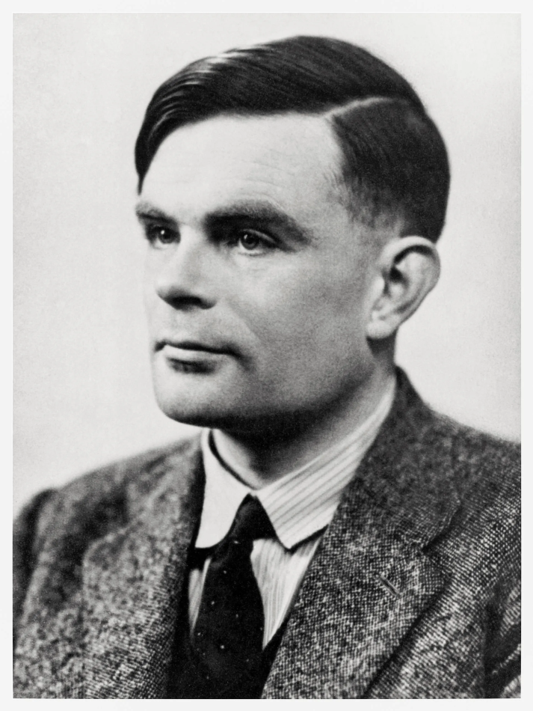
Turing Machines
Alen Turing(1912-1954)
Imperative Programming : Sequences of commands, explicit state transitions, update via assignment
Example : Lisp

Slide 25
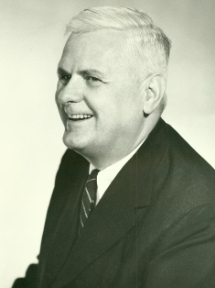
Lambda Calculus
Alonzo Church(1903-1995)
Formal basis for all functional languages, Semantics,
Type theory
Functional Programming : Pure expression evaluation, No assignment operator
Examples : Haskell, Groovy
Functional Languages:
It is easier to describe the complex program.
Portability and Resolvability are more important than Efficiency
For this reason, they are more Interpretive and on a Virtual Machine.
They are generally High Level

Slide 26
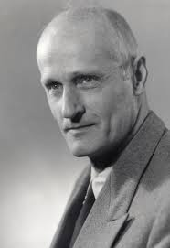
Automata Theory
Recursive Functions & Automata
Stephen Kleene(1909-1994)
Regular expressions
finite-state machines
PDA(pushdown automaton)

Slide 27
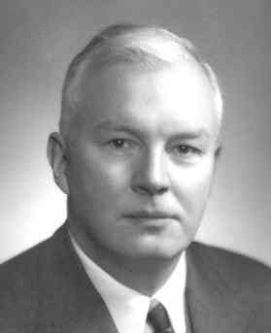
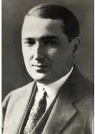
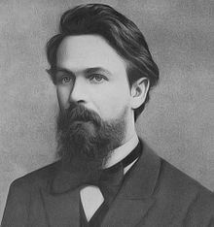
Others
Combinatory Logic
Moses Schonfinkel, Logition(1889-1942)
Haskell Curry(1900-1982)
Effective in the development of functional languages
Post Production Systems
Emil Post(1897-1954)
Markov Algorithms
Andrey Markov(1903-1979)

Slide 28
Chapter 3
Paradigms

Slide 29
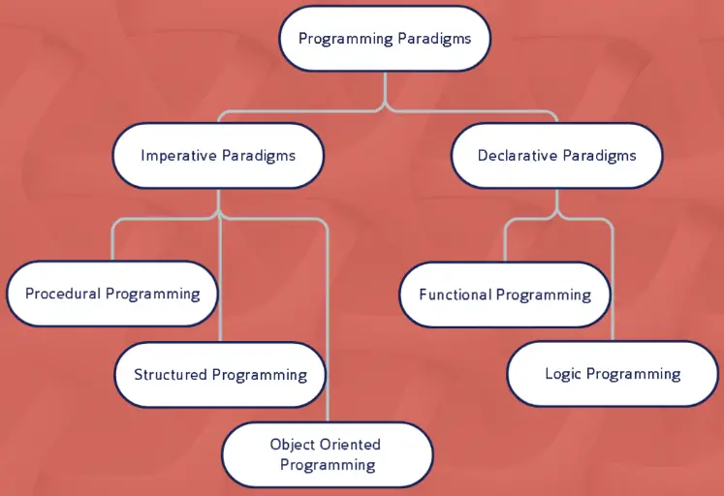
Paradigms
Main Paradigms :

Slide 30
Paradigms
Imperative Programming
Imperative programming is a programming paradigm that uses statements to change a program’s state. It’s concerned with describing how a program operates in a step-by-step manner.
Statements are executed, and the results are stored in variables. It is more of a line-by-line instruction given to the computer.
Let us understand imperative programming using a C++ program that gives us factorial of a number.
Imperative programming can be further divided into procedural, structured, and object-oriented programming.

Slide 31
Paradigms
Procedural Programming :
Procedural programming can also be referred to as imperative programming. It is a programming paradigm based upon the concept of procedure calls, in which statements are structured into procedures (also known as subroutines or functions). They are a list of instructions to tell the computer what to do step by step, Procedural programming languages are known as top-down languages. Most of the early programming languages are all procedural.
Features:
Procedural Programming is excellent for general-purpose programming
The coded simplicity along with ease of implementation of compilers and interpreters
A large variety of books and online course material available on tested algorithms, making it easier to learn.
The source code is portable
The code can be reused in different parts of the program, without the need to copy it
The program flow can be tracked easily as it has a top-down approach.
Examples of Fortran C and Cobol

Slide 32
Paradigms
Structured Programming :
It is an imperative programming paradigm where we use nested loops, conditional statements, and subroutines to define the control flow of a program. This paradigm has a top-down implementation which promotes code readability and reusability. In commercial applications, this helps to reduce development time and increase code quality.
Structured programming uses control structures like loops (for, while), conditionals (if, switch), and subroutines to control the program’s flow. These structures enable programmers to write code that is easier to understand and modify, because they provide a clear, top-down control flow.
While structured programming improves the readability and organization of code, it can lead to more complex code structures in larger programs. It may also require more overhead in terms of planning and design compared to less structured paradigms.
However, this doesn’t necessarily mean that structured programming languages are less efficient in execution. The efficiency often depends on the implementation details and the specific problem being addressed.
Some of the languages that use Structured programming paradigms are:
Algol 60
PL/I
Pascal
Ada 83
Modula

Slide 33
Paradigms
Object-Oriented Programming(OO):
In this framework, all real-world entities are represented by Classes. Objects are instances of classes so each object encapsulates a state and behavior. State implies the fields, attributes of the object and behavior is what you do with the state of the object and they are the methods. Objects interact with each other by passing messages.
Features :
Encapsulation : It is the binding of data into a single unit.
Inheritance : It helps in establishing hierarchical relationships promoting code reusability.
Abstraction : It helps in hiding unnecessary attributes while showing the ones required.
Polymorphism : It allows different objects to respond in different ways to the same input.
Programming languages that have implemented the OO paradigm are: Ruby, Java, C++, C#, Python, Simula (the first OOP language)

Slide 34
Paradigms
Declarative Programming :
Declarative programming is a programming approach that expresses a computation’s logic without discussing its control flow. The programmer must specify what the program must accomplish but need not specify how it must be implemented.
In other words, rather than dictating ‘how’ to achieve a goal, as is common in imperative programming, declarative programming focuses on ‘what’ needs to be achieved, leaving the specifics of ‘how’ to the underlying system or language implementation.
While you don’t have to specify ‘how’ to achieve something, the ‘how’ is still important – it’s just handled by the system or the language implementation, not the programmer.
The declarative programming paradigm is further divided into logic programming and functional programming.

Slide 35
Paradigms
Logical Programming:
Logical programming is a computer programming paradigm that has its foundations in mathematical logic in which program statements express facts and rules about problems within a system. Rules are written as logical clauses with a head and a body. They also follow a declarative rather than an imperative approach. However, what does that mean?
To understand how a problem can be solved in logical programming, you need to know about the building blocks − Facts and Rules − like Prolog, ACL2, Isabelle and HOL
There are three basic statements:
Facts are fundamental assertions about the problem domain (e.g. “Moses is a man")
Rules are inferences about facts in the domain (e.g. "All men are mortal.")
Queries are questions about that domain (e.g. "Is Moses mortal?")
Features:
Logical programming can be used to express knowledge in a way that does not depend on the implementation, making programs more flexible, compressed and understandable.
It enables knowledge to be separated from use, i.e. the machine architecture can be changed without changing programs or their underlying code.
It can be altered and extended in natural ways to support special forms of knowledge, such as meta-level of higher-order knowledge.
It can be used in non-computational disciplines relying on reasoning and precise means of expression.

Slide 36
Paradigms
Functional Programming :
Functional programming is a programming paradigm where you have a style of building the structure and elements of computer programs. Here you treat computation as an evaluation of mathematical functions and you avoid changing-state and mutable data.
Functional programming consists only of PURE functions. So, what do you understand by Pure functions?
Pure functions are those which take an argument list as an input and whose output is a return value. Now you may feel that all functions are pure as any function takes in values and returns a value.
Features :
Pure functions
Recursion
Referential transparency
Functions are First-Class and can be Higher-Order
Variables are Immutable
Programming Languages that support functional programming: Haskell, JavaScript, Scala, Erlang, Elixir, Lisp, ML, Clojure, OCaml, F#, Common Lisp, Racket.

Slide 37
Paradigms at the Glance
Imperative: Programming with an explicit sequence of commands that update state.
Declarative: Programming by specifying the result you want, not how to get it.
Structured: Programming with clean, goto-free, nested control structures.
Procedural: Imperative programming with procedure calls.
Functional (Applicative): Programming with function calls that avoid any global state.
Function-Level (Combinator): Programming with no variables at all.
Object-Oriented: Programming by defining objects that send messages to each other. Objects have their own internal (encapsulated) state and public interfaces. Object orientation can be:
Class-based: Objects get state and behavior based on membership in a class.
Prototype-based: Objects get behavior from a prototype object.
Event-Driven: Programming with emitters and listeners of asynchronous actions.
Aspect-Oriented: Programming cross-cutting concerns applied transparently.
Reflective: Programming by manipulating the program elements themselves.
Array: Programming with powerful array operators that usually make loops unnecessary.

Slide 38
Most Important Programming Language
N | Title | Date | Imples | Style | Domain
1 | Fortran | 1957 | ------ | Structured | Modeling, Calc
2 | Cobol | 1959 | ------ | Proc, OOP | Business
3 | VB | 1991-1998 | ------ | Object-Based | Business
4 | FoxPro | 1991-2015 | ------ | Proc, OOP | DBMS
5 | Lua | 1993 | C | Imperative | System, Game
6 | Erlang | 1986 | Erlang/C | Concurrent, Functional | Infrastructure
7 | Haskell | 1990 | Haskell/C | Functional | Research, Industry, Enterprise App
8 | oCaml | 1996 | oCaml/C | Functional,OOP | Sys,Web,Fin
9 | Perl | 1987 | C | Functional, OOP | Text Processing
MP : Multi-Paradigm, Calc : Calculation, OOP : Object-Oriented Programming

Slide 39
Most Important Programming Language
N | Title | Date | Implemented | Style | Domain
10 | JS/TS | 1995 | ------ | Event-Driven | Web
11 | Python | 1991 | C | OOP, Func | AI, Startup
12 | C/C++ | 1978 | C-Ada/C++ | Structured, Proc | System
13 | Java | 1995 | ---- | OOP | Financial
14 | C# | 2001 | ---- | OOP | Business/Org
15 | Go | 2011 | Go | Concurrent, OOP | Backend/IO
16 | R | 1993 | C/Fortran | Proc | Data Analysis
17 | PHP | 1995 | C/C++ | Imperative | Web-Backend
18 | Rust | 2015 | C/C++ | Concurrent, Func | System
19 | Solidity | 2014 | C++ | OOP | Blockchain
20 | Clojure
21 | Julia
MP : Multi-Paradigm, Proc : Procedural, Func : Functional

Slide 40
Chapter 4
Languages

Slide 41
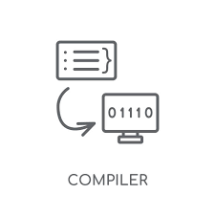
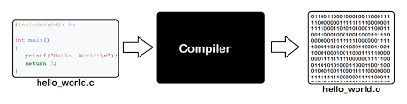
Translate Code
Source Code
Byte-Code
Native Code
Virtual Machine
Interpreter
Compiler
Just-In-Time Compiler(JIT)
1-A Compiler is a special program that translates a programming language's source code into machine code, bytecode or another programming language

Slide 42
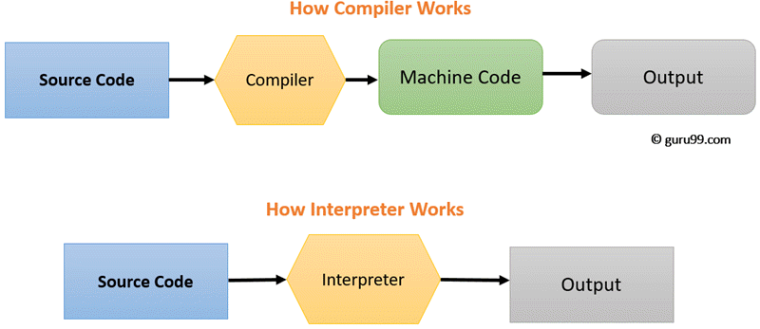
Translate Code
An Interpreter is a computer program that directly executes instructions written in a programming or scripting language, without requiring them previously to have been compiled into a machine language program. An interpreter generally uses one of the following strategies for program execution:
Parse the source code and perform its behavior directly;
Translate source code into some efficient intermediate representation or object code and immediately execute that;
Explicitly execute stored precompiled bytecode made by a compiler and matched with the interpreter Virtual Machine.

Slide 43
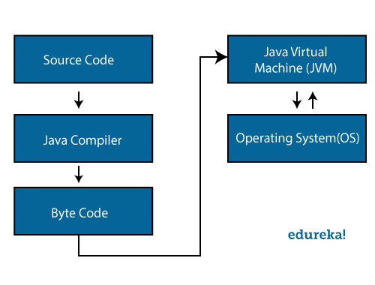
Translate Code
Virtual Machine or Language Runtime System
For example Java Virtual Machine(JVM)

Slide 44
Languages studied
N | Language | Desired Paradigm | N of Session
1 | Review of Assembly Language | Structured | 1
2 | C | Procedural | 1
3 | C++ | Object Oriented | 1
4 | Rust | Functional | 1
5 | Go | Concurrent | 3
6 | Java Script | Event-Driven | 4
7 | Solidity | Object Oriented | 1

Slide 45
Paradigms
A programming paradigm is a style, or “way,” of programming.
N | Paradigm | Languages
1 | Procedural | C, JavaScript
2 | Functional | Rust, JavaScript
3 | Object-Oriented | C++, JavaScript
4 | Concurrent | Rust, Go
5 | Event-Driven | JavaScript
6 | Imperative | Rust, Go, JavaScript
7 | Generic | Rust, Go, C++
8 | and etc…

Slide 46

Issues
Metaprogramming : It is writing programs that operate on other programs
Reflection : Reflection is the ability of a program to introspect and analyze its structure during run-time.
Concurrency
Classes
Object Orientation
Functional Programming
Subroutines
Expression Evaluation
Binding
OHM Library
Language Theory
Context Free Grammar

Slide 47

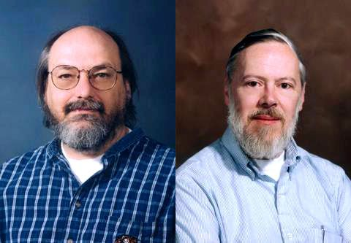
C Language and Procedural Paradigm
C is a general-purpose computer programming language. It was created in the 1970s by Dennis Ritchie, and remains very widely used and influential. By design, C's features cleanly reflect the capabilities of the targeted CPUs.
It has found lasting use in operating systems, device drivers, protocol stacks, but its use in application software has been decreasing. C is commonly used on computer architectures that range from the largest supercomputers to the smallest microcontrollers and embedded systems.
Paradigm : Multi-paradigm: imperative (procedural), structured
Designed by Dennis Ritchie, Ken Thompson
Major implementations : GCC, Clang
Every action is Function
Anything that is 0 is true and anything that is not 0 is true
Early C++, Modula-3, Eiffel source-translated to C

Slide 48
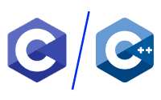
C++ Language and Object Oriented Paradigm
C and C++ are often referred to as low-level languages. They are especially useful for building high-performance systems. C++ can be thought of as an extension to the C language, adding features like object-oriented programming. A few projects that use these languages include the Linux Kernel, which is written in C, and Adobe Photoshop, which is written in C++.
C and C++ may seem intimidating because of the added complexity of the way you manage and interact with the programs’ memory. However, learning C and C++ can provide you with a strong foundation in programming, making it easy to understand more nuanced concepts.
C++ = C + Simula
C++ Features:
Multiple Inheritance
Templates/Generics
Exception Handling
C Framework :
Unlimited…
C++ Framework :
Qt
ROOT
Ffead-Cpp
Boost
C++ Application:
Everywhere
C Application:
Everywhere

Slide 49

Rust Language and Functional Paradigm
Rust is another general-purpose programming language based on C and C++. Rust is strict on how you interact with memory. This approach minimizes the possibility of bugs or vulnerabilities in programs while maintaining a high level of performance. As a result, Rust is an increasingly popular choice for building systems where safety and security are essential.
One great demonstration of how Rust is used can be found in the Firefox browser itself. It was used to improve the efficiency of the CSS engine while simultaneously reducing the number of potential security vulnerabilities. Even though Rust is especially appropriate for system-level programming, it’s not unheard of for people to start their programming journey with Rust.

Slide 50
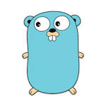

Golang Language and Concurrent Paradigm
Go, also known as Golang, is a general-purpose programming language developed by Google with syntax and use cases similar to C and C++. Its goals were to simplify the syntax and general complexity of these and other languages. Go can be used in systems engineering, software engineering, and data science.
Go is often used to implement components of larger projects where execution speed is important. For example, in 2014, Dropbox used Go to improve the performance of its backend systems, especially concerning access to its database
Framework :
Gin
Revel
Beego
Application:
Backend

Slide 51
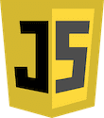
JavaScript Language and Event-Driven Paradigm
JavaScript is commonly used with HTML and CSS to implement client-side functionality using small scripts. This is why it’s often called a scripting language. You can use JavaScript to add features like dropdown menus and web applications to your website. It is beginner-friendly in that it doesn’t need a compiler to run, most browsers can serve as the default environment.
Beyond that, you can utilize frameworks like Node.js to use JavaScript in server-side programming. It is powerful enough to accomplish tasks like implementing a search algorithm, analyzing data provided by a user, or solving mathematical equations. There are even game engines built with JavaScript that can have impressive results.
Framework :
Node.js
Angular, React.js and Vue js
Meteor and Expo
Application:
Web
Mobile
Desktop

Slide 52

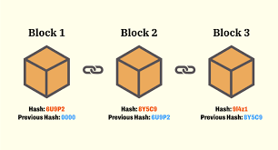
Blockchain and Smart Contract
A Blockchain is a decentralized, distributed and public digital ledger that is used to record transactions across many computers so that the record cannot be altered retroactively without the alteration of all subsequent blocks and the consensus of the network.
* Java family get great position in Blockchain field near soon
Blockchain Languages :
C/C++
JS/TS
Golang
Rust
Smart Contract Languages :
Solidity
Vyper
Also all above languages

Slide 53

Solidity
Solidity is an object-oriented programming language for implementing smart contracts on various Blockchain platforms, most notably, Ethereum.
Designed by: Gavin Wood
Developer: Christian Reitwiessner, Alex Beregszaszi
First appeared: August 2014
Implementation language: C++
Paradigm: Object-oriented

Slide 54
Exercises
Chat program between two computers
Client and Multi-threaded Server Program for send a file

Slide 55

The end of the journey

Slide 56
References

Slide 57
References
Programming paradigm
https://en.wikipedia.org/wiki/Programming_paradigm
https://cs.lmu.edu/~ray/notes/paradigms/
Functional Paradigm
https://www.geeksforgeeks.org/functional-programming-paradigm/
C++ Language
https://www.cs.mtsu.edu/~xyang/2170/
Reactjs
https://reactapp.ir/
Programming language theory
https://en.wikipedia.org/wiki/Programming_language_theory
https://academic-accelerator.com/encyclopedia/programming-language-theory
https://cs.lmu.edu/~ray/notes/languagetheory/
Language Theories
https://cs.lmu.edu/~ray/notes/languagetheory/
https://en.wikipedia.org/wiki/Programming_language_theory
Others
https://cs.lmu.edu/~ray/
https://cs.lmu.edu/~ray/classes/pls/
https://careerkarma.com/blog/easiest-programming-languages-to-learn/

Slide 58
References
Others
https://blog.faradars.org
https://hackr.io/blog/programming-paradigms
https://www.cs.cornell.edu/courses/cs4110/2012fa/
System Programming
https://www.systutorials.com/hashing-library-for-c/

Slide 59
Appendices
Appendices

Slide 60
Comparison of two Languages
N | Title | Student
1 | Python vs Julia | Parsa Arianpoor
2 | PHP vs Ruby | Abdorahman Bigonahi
3 | PowerShell vs Bash | Aliakbar Makarian
4 | C# vs Java | Sina Abbasi, Alireza Sharifi
5 | Kotlin | Mohammadreza HaydariKia
6 | Objective-C vs Swift
7 | Erlang vs Elixir | Mohammad Farazendeh, Omidreza Sanjari
8 | Lua vs Perl | S. Mickaeil Sediqe, Ali Qanbari
9 | Haskell | Fardin Sedaqat
10 | oCaml
11 | Elm vs Dart | Amin Khoshi, Abbas Kargar Jahromi
12 | Golang | Mahdi Salari
13 | Scala | Mohammadhadi Jedabi
*Students must write one or two report on the language presented.

Slide 61
Report of a Languages
N | Students | Languages
1 | Dart | Alireza Naseri****
2 | Rust | Mohammadsadeq Mohebi
3 | Golang | Mohammadamin Naseri
4 | Groovy
5 | Solidity | M.Hossein Khabiri
6 | F# | Ali Hajihossini
7 | C++ | Mohammad Salehi
8 | C | Yasin Shahriari
9
10
11
12
13

Slide 62
Mini Project
CRUD on JSON file
Client/Server chat system
Upload file on system
CRUD on Database by RESTful API
Hash and Encryption Data by RESTful API
Sorting Algorithm by RESTful API
Searching Algorithms by RESTful API
Store Linked-List in JSON file
Sample Email System behind a RESTful API

Slide 63
Tools
Postman
Jira
Git, Github and GitLab
Chrome or Firefox DevTools
Stack Overflow
Docker

Slide 64
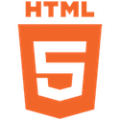
1-HTML
HTML is a markup language used in web development and is said to be one of the easiest coding languages to learn for newbies.
HTML stands for Hypertext Markup Language. It is one of the three basic building blocks of the web. You might recognize “HTML” as part of a link to a website or in your browser’s address bar. Although it isn’t technically a programming language, learning how to create an HTML page is often the first step in expanding your coding knowledge.
HTML is commonly used alongside JavaScript and CSS for front end web development. HTML is great for beginners because it has a simple structure with easy-to-define opening and closing tags. You also use elements in HTML to decide how text, images, and other interactive buttons are shown on a web page.

Slide 65
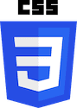
2-CSS
Cascading Style Sheets (CSS) is designed to be a simple coding language. It is used to customize the appearance of a website and define how it should look when viewed in a browser. You can use CSS to define animations, hide or show certain content, and control the positioning of the page’s elements. CSS can improve the look, readability, and functionality of a website.
In fact, the article you’re reading right now is built with HTML, CSS, and JavaScript. CSS is an ideal language for beginners because, like HTML, it will help you execute basic development tasks.

Slide 66
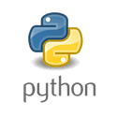
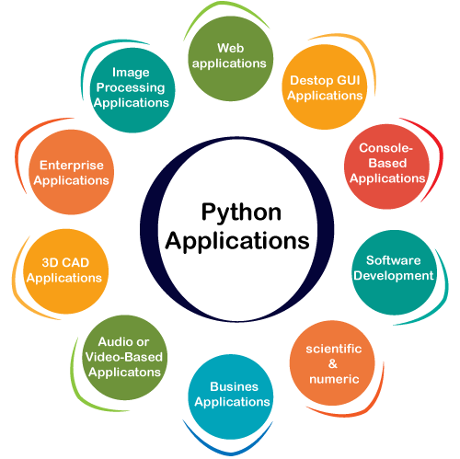
4-Python
Python is a general-purpose coding language designed with readability in mind. As one of the easiest programming languages, it’s often used as an introductory language for computer science students in college. Python is very versatile and can be used to develop applications, automate processes, build operating systems, and more.
Python makes an excellent choice for beginners because it uses a simple syntax, comparable to the English language. This can make coding less intimidating for beginners. Python is also supported by a huge community of developers with lots of resources available to help beginners find their footing.
Framework :
Django
Flask
Application:
Web
AI

Slide 67

5-Ruby
Ruby is a powerful programming language with a focus on simplicity and productivity. Ruby is often compared to Python, as the two languages have common use cases and similar features. With Ruby, you can perform complex tasks using minimal code. Companies like Airbnb, Hulu, and Shopify reportedly use Ruby in their tech stacks for web development.
It is also an open-source programming language which means beginners have access to plenty of resources like tutorials, books on Ruby programming, and online discussions. Ruby is commonly used with its framework Rails to create dynamic and responsive web applications.

Slide 68
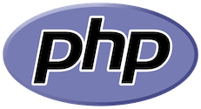
7-PHP
PHP, or Hypertext Preprocessor, is one of the easiest programming languages to learn, especially if you already know HTML. It is mainly used to provide the backend server functionality that is essential to many websites today. PHP makes it easy for developers to retrieve and store data in databases while also processing and replying to users’ requests.
Creating your first PHP program is as easy as embedding PHP code into an HTML page and uploading the file to a server that can process it. Many online resources can help you learn PHP. Some notable projects and services that use PHP include Facebook, Tumblr, and WordPress.
Framework :
CakePHP
Laravel
Symfony
Phalcon
Application:
Web

Slide 69
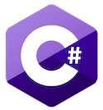
9-C#
C# is a general-purpose coding language that is developed by Microsoft for Microsoft. It can be used to develop web apps, cloud-based services, enterprise software, and more. It also provides full support for object-oriented programming. Perhaps one of the most recognizable use cases of C# is game development using the popular Unity game engine.
Framework :
Dot NET
Xamarin
Application:
Web, Mobile and Desktop

Slide 70

10- R
R is a coding language that is primarily used for data science, deep learning, and machine learning. If you’re just starting with programming, you may find that R has a steep learning curve. However, there are a lot of R add-on tools like RStudio and lintr that can help simplify the process.
Like Python, R is commonly used to perform statistical analysis of data, build web applications, and write scripts to accomplish various tasks. Learning R is a great option if you’re considering becoming a data scientist or simply love working with statistics.
Application:
Data Analysais

Slide 71
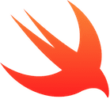
13-Swift
Apple developed Swift in 2014 specifically for use within its own technological ecosystems like macOS and iOS. Swift is also easy to read and write, so it’s a good option for novice programmers. To guide beginning coders through the Swift programming language, Apple created a free application called Swift Playgrounds.
Even if you have zero programming experience, Swift Playgrounds can help you quickly learn the fundamentals of Swift before moving on to more complex concepts. Swift Playgrounds provides direct guidance as you learn Swift, and it’s a useful resource that will teach you skills applicable to any programming field.
Framework :
Alamofire
RxSwift
Snapkit
Application:
Apple Products
Web, Mobile and Desktop

Slide 72

14-Erlang
Erlang is a functional, general-purpose programming language. As one of the easiest programming languages for beginners, it made its first appearance in 1986 with a focus on concurrent programming. That means its features are ideal for building systems where multiple, distinct processes need to run simultaneously while still communicating with each other.
Unlike other programming languages on this list, Erlang only supports functional programming. It emphasizes the use of mathematical functions to accomplish tasks. This type of programming usually reduces the reliance on an external state or data. Ultimately, it is easier to debug and more likely to be executed safely alongside other processes.

Slide 73
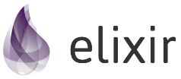

15-Elixir
Designed by: José Valim(2012)
A high concurrency and low latency programming language, it is most commonly used to build scalable and versatile applications, with additional support for low latency and fault tolerance. When your task is to design an app to take loads of requests, Elixir is the answer, for it combines the best features of Erlang, Ruby, and Clojure languages and supports multithreaded applications.
Functional Programming,, Reliability. Scalability
Metaprogramming, Polymorphism, Parallel, Concurrency, Pattern Matching
Used for Web Programming and claim for embedded System
You are able to directly change Abstract syntax tree (AST)
Used by Discord, Pinterest, WhatsApp, Heroku

Slide 74
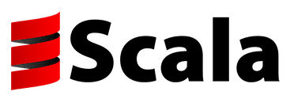
16- Scala
Scala builds on a foundation laid by Java, making it one of the best programming languages to learn for beginners. It brings a focus on functional programming and concise, flexible syntax. Scala’s additions make it easier for expert developers to solve problems more efficiently. Scala is commonly used in data processing, web development, and data engineering.
Twitter first picked up Scala for performance reasons in 2009, and it is perhaps one of the largest Scala users. Most online learning resources for Scala assume you already have at least some experience in programming

Slide 75

17-Clojure
Clojure is a functional programming language based on Lisp, a language that first appeared in 1958 with a unique parenthetical syntax. Clojure added features like immutable data structures to Lisp which makes it easier to write concurrent systems. Companies like Walmart use Clojure for backend services to build systems that can handle large volumes of activity.
Considering Clojure’s focus on being useful for concurrency, it’s not surprising that it’s often used for building services where this is important

Slide 76

18-Groovy
Derived from Java, Groovy was developed by James Strachan and Bob McWhirter. The language improves productivity because of its succinct and easy to learn. Some well-known companies that are using Groovy in their tech stacks are Starbucks, Transferwise, and Craftbase.

Slide 77

19-Haskell
Haskell is a general-purpose programming language named after the American logician and mathematician Haskell Brooks Curry. It is a purely functional programming language meaning it’s primarily mathematical. It’s used across multiple industries particularly those that deal with complicated calculations, records, and number-crunching. Like many other programming languages from this era, it is not overly common to see Haskell in use for well-known applications. With that said, the programming language has been used to write a number of games one of which is Nikki and the Robots.

Slide 78
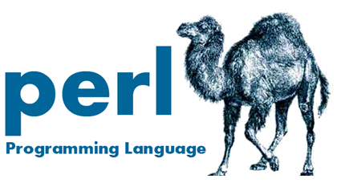
20-Perl
Perl was created by Larry Wall and is a general-purpose, high-level programming language. It was originally designed as a scripting language designed for text editing but nowadays it’s widely used for many purposes such as CGI, database applications, system administration, network programming, and graphic programming.

Slide 79
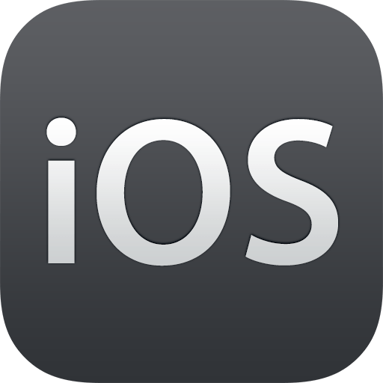
21-Objective-C
Developed by Brad Cox and Tom Love, Objective-C is the main programming language used to write software for macOS and iOS, Apple’s operating systems.

Slide 80
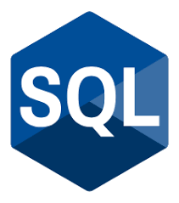
22-SQL (SEQUEL at the time)-1972
SQL was first developed by IBM researchers Raymond Boyce and Donald Chamberlain. SEQUEL (as it was referred to at the time), is used for viewing and changing information that is stored in databases. Nowadays the language is an acronym – SQL, which stands for Structured Query Language.
Application:
Relational Database

